Slide 1
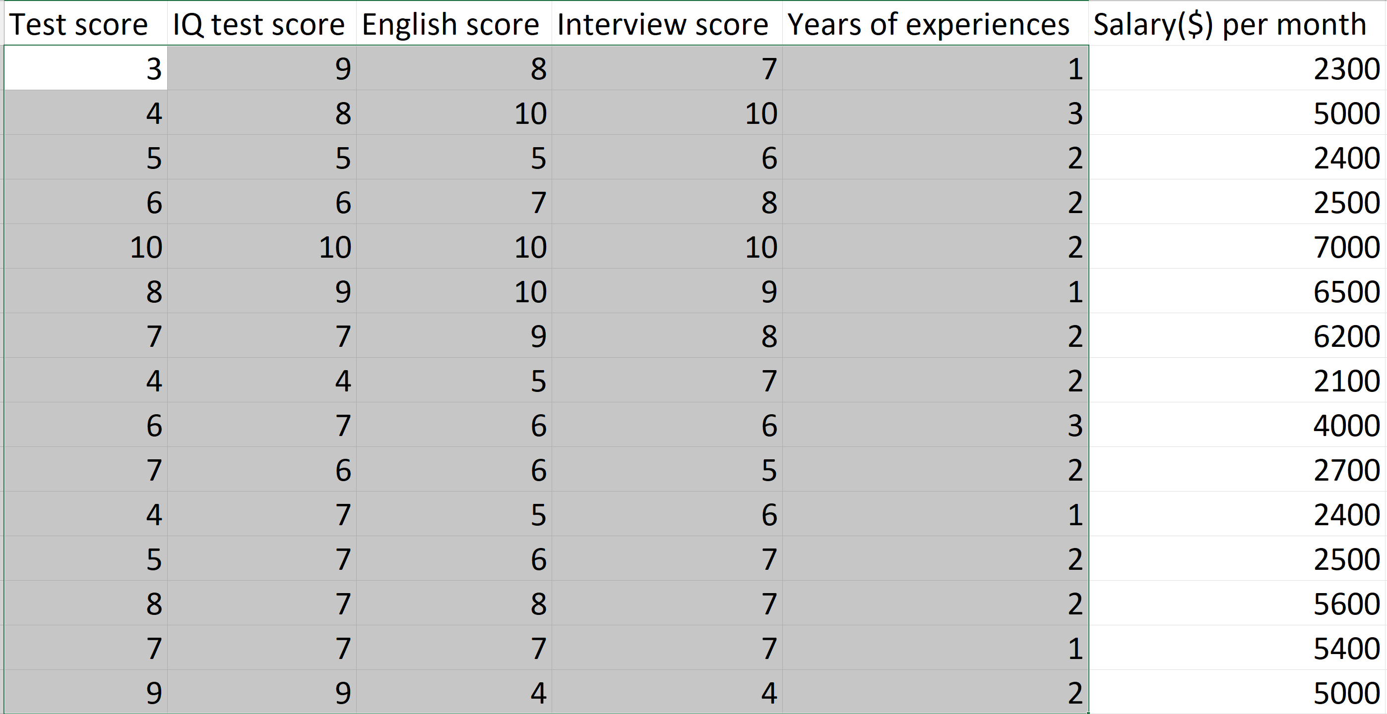
Model
Input
(features)
Output
(label)

Slide 2
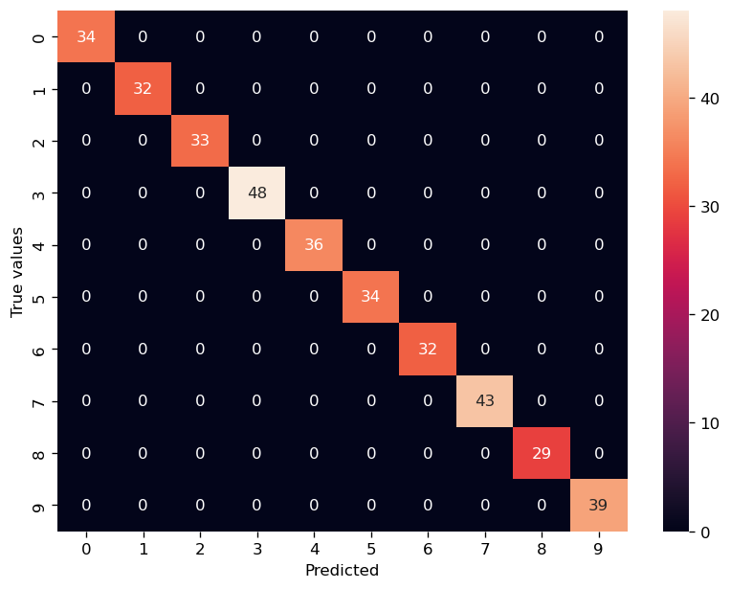
Hồi quy Logistic
nhiều biến

Slide 3
digits[‘data’]
Digits[‘target’]
(output)
digits[‘images’]
8x8
0
64 features
8x8
1
64 features
1797 rows
2
5
9
8x8
64 features
1

Slide 4
digits[‘data’]
Digits[‘target’]
(output)
80%
64 features
0
1
64 features
1797 rows
2
5
9
20%
64 features
1

